Slide 1


QUESTIONS
DATA ANALYTICS (ONLINE)
The impact of COVID-19 in relation to
Unemployment
Crime
In the Kansas City Missouri Area
DATA SUMMARY
DATA EXPLORATION
ANALYSIS
SUMMARY
IMPLICATIONS
Team Members:
Natalie Shaw
Eric Weber
Kevin Smith
FOR REVIEW
GROUP 4: PROJECT 1

Slide 2
QUESTIONS
DATA ANALYTICS (ONLINE)
DATA SUMMARY
DATA EXPLORATION
HYPOTHESIS
Covid-19 rates in the Kansas City Metropolitan area have had an impact on
Crime and 2)Unemployment rates for the time period of
October 2019 – December 2020
ANALYSIS
SUMMARY
IMPLICATIONS
FOR REVIEW
GROUP 4: PROJECT 1

Slide 3



QUESTIONS
DATA ANALYTICS (ONLINE)
1
COVID -19
CRIME
UNEMPLOYMENT
NATALIE SHAW
KEVIN SMITH
ERIC WEBER
DATA SUMMARY
DATA EXPLORATION
2
ANALYSIS
3
NATALIE SHAW
KEVIN SMITH
ERIC WEBER
SUMMARY
COVID -19
COVID -19
CRIME
UNEMPLOYMENT
MINING
ANALYSIS
IMPLICATIONS
4
COVID -19
UNEMPLOYMENT
CRIME
FOR REVIEW
NATALIE SHAW
KEVIN SMITH
ERIC WEBER
GROUP 4: PROJECT 1 (PLAN)

Slide 4
QUESTIONS
DATA ANALYTICS (ONLINE)
DATA SUMMARY
Was there an impact on crime rates and unemployment due to the COVID-19 Pandemic in the Kansas City Metropolitan Area?
If so, can we discover a correlation between the variables?
Was there a rise in crime and if so what types?
Was the rise in crime due to unemployment? How can we highlight that relationship if one exists?
Did the COVID-19 pandemic influence one of the variables more than the other?
Was there any impact at all?
What should we use as benchmark (time wise)?
What kind of crimes were we going to use for our data?
Should we incorporate demographics?
DATA EXPLORATION
ANALYSIS
SUMMARY
IMPLICATIONS
FOR REVIEW
GROUP 4: PROJECT 1

Slide 5

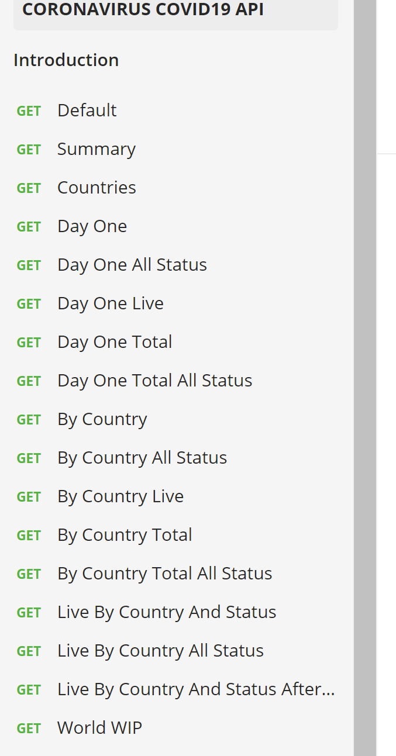
QUESTIONS
DATA ANALYTICS (ONLINE)
DATA SUMMARY
COVID-19
https://covid19api.com/
Free API on the coronavirus
Data is sourced from John Hopkins CSSE (Center for Science and Systems and Engineering)
Through Postman (at bottom of site)
You can get data pre-sorted by category
DATA EXPLORATION
ANALYSIS
SUMMARY
IMPLICATIONS
FOR REVIEW
GROUP 4: PROJECT 1

Slide 6

Start Date End Date Total Incidents
0 2019-10-01 2019-10-31 96
1 2019-11-01 2019-11-30 110
2 2019-12-01 2019-12-31 126
3 2020-01-01 2020-01-31 0
4 2020-02-01 2020-02-29 0
5 2020-03-01 2020-03-31 0
6 2020-04-01 2020-04-30 0
7 2020-05-01 2020-05-31 0
8 2020-06-01 2020-06-30 0
9 2020-07-01 2020-07-31 0
10 2020-08-01 2020-08-31 0
11 2020-09-01 2020-09-30 0
12 2020-10-01 2020-10-31 12478
13 2020-11-01 2020-11-30 13825
14 2020-12-01 2020-12-31 15196
QUESTIONS
DATA ANALYTICS (ONLINE)
DATA SUMMARY
CRIME
Data provided by instructor, Ben (thank you)
Incident-based crime API for KC Metro
Data from local police agencies
Location and incident type
Aggregated on a monthly basis
Volume and trends in crime over time
DATA EXPLORATION
Kansas City Police Dept.
Liberty Police
Riverside Dept. of Public Safety
Blue Springs Police Department
North Kansas City Police Dept.
University of Kansas Public Safety Office
St. Joseph Police Dept.
ANALYSIS
SUMMARY
IMPLICATIONS
FOR REVIEW
GROUP 4: PROJECT 1

Slide 7
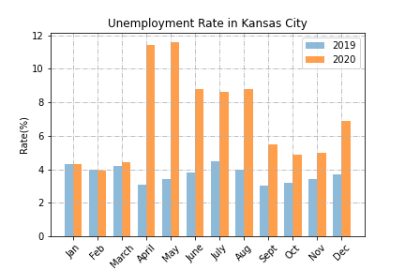
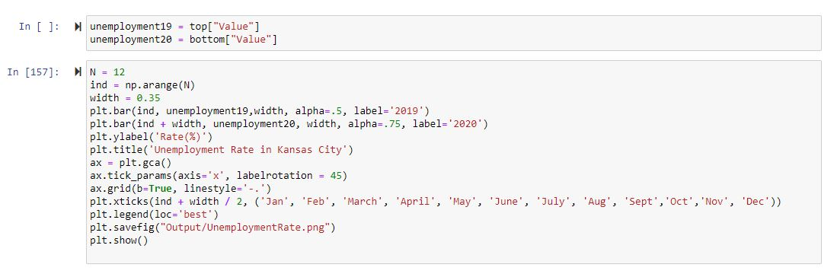
QUESTIONS
DATA ANALYTICS (ONLINE)
DATA SUMMARY
UNEMPLOYMENT
Unemployment data found at: https://www.bls.gov/data/#unemployment
Unemployment data collected on a monthly basis from Kansas City, Mo in 2019 and 2020 to show the impact COVID-19 had on the economy.
DATA EXPLORATION
ANALYSIS
SUMMARY
IMPLICATIONS
FOR REVIEW
GROUP 4: PROJECT 1

Slide 8
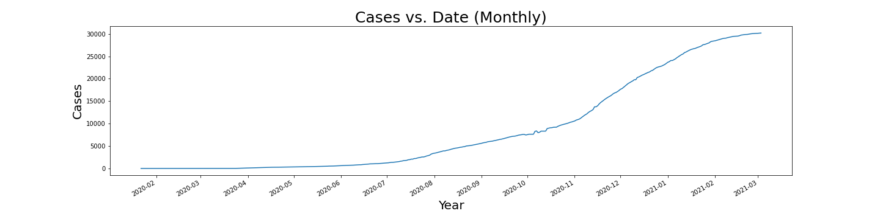
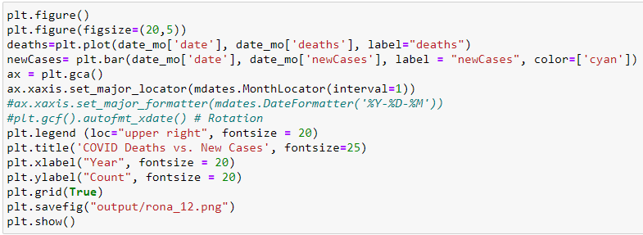

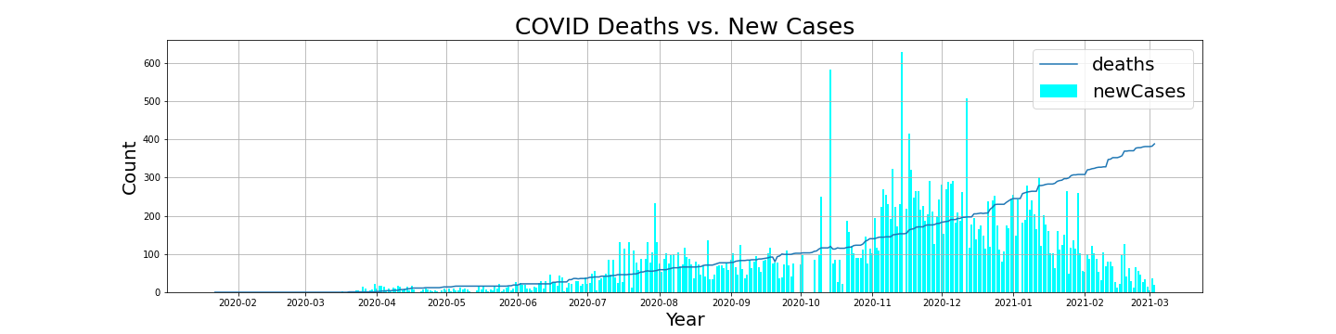
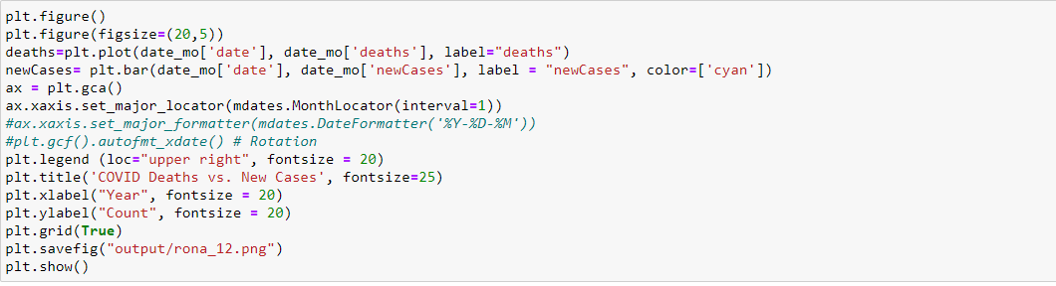
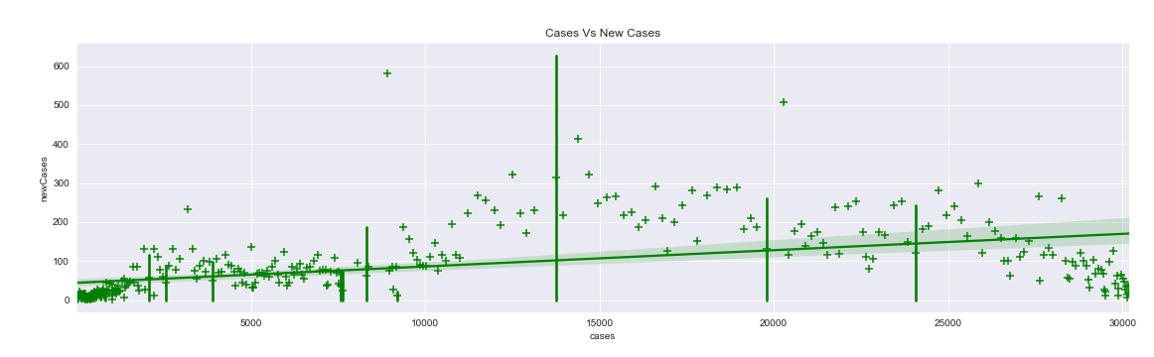
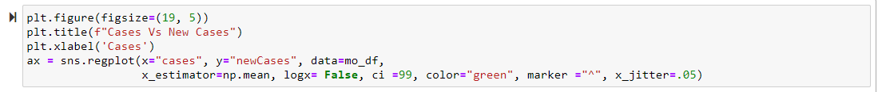
QUESTIONS
DATA ANALYTICS (ONLINE)
Linear vs. Non Linear equations (“The Baseline”)
DATA SUMMARY
DATA EXPLORATION
COVID-19
ANALYSIS
SUMMARY
IMPLICATIONS
FOR REVIEW
GROUP 4: PROJECT 1

Slide 9
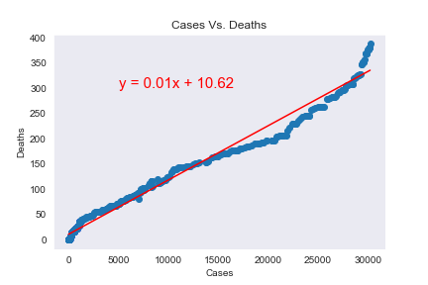
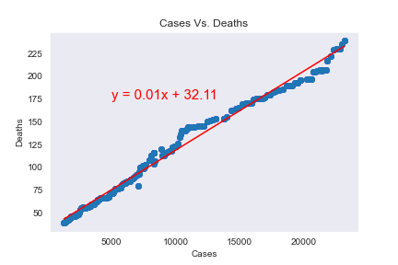
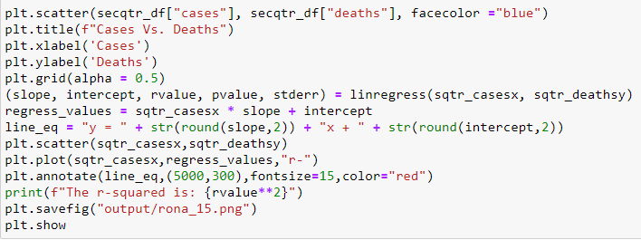
QUESTIONS
DATA ANALYTICS (ONLINE)
Correlation of Cases vs. Deaths
DATA SUMMARY
March 1st 2020 – June 30th 2020
July 1st 2020 – December 30th 2020
DATA EXPLORATION
COVID-19
ANALYSIS
SUMMARY
IMPLICATIONS
The r-squared is: 0.9825204775479639
The r-squared is: 0.9878841847717416
FOR REVIEW
GROUP 4: PROJECT 1

Slide 10
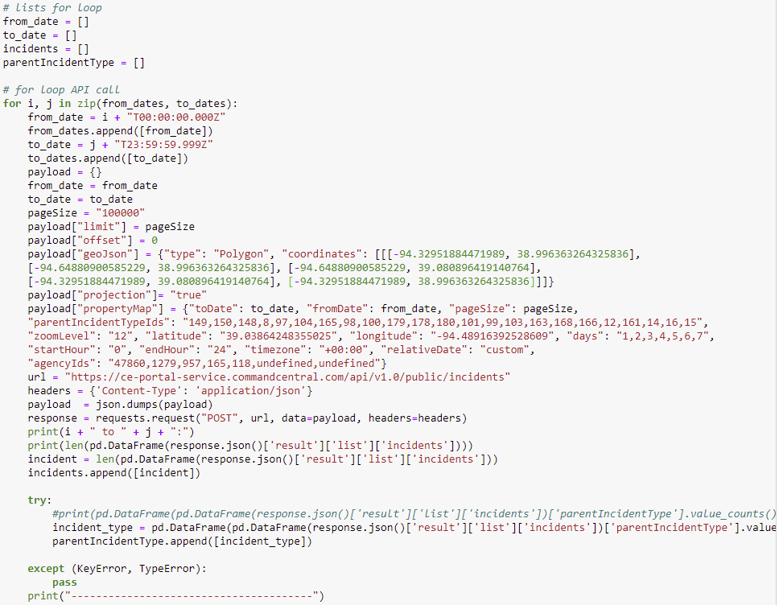
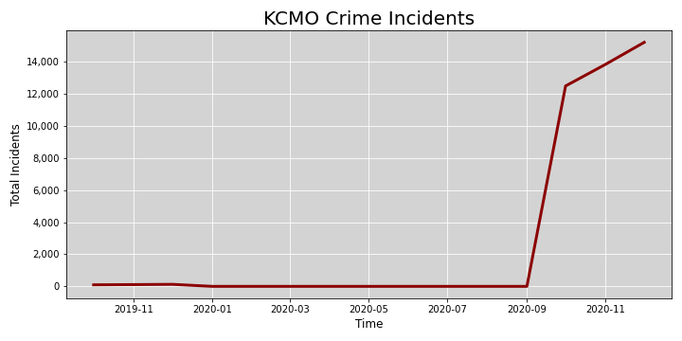
QUESTIONS
DATA ANALYTICS (ONLINE)
For Loop for API Call (Crime)
DATA SUMMARY
DATA EXPLORATION
CRIME
ANALYSIS
SUMMARY
IMPLICATIONS
FOR REVIEW
GROUP 4: PROJECT 1

Slide 11
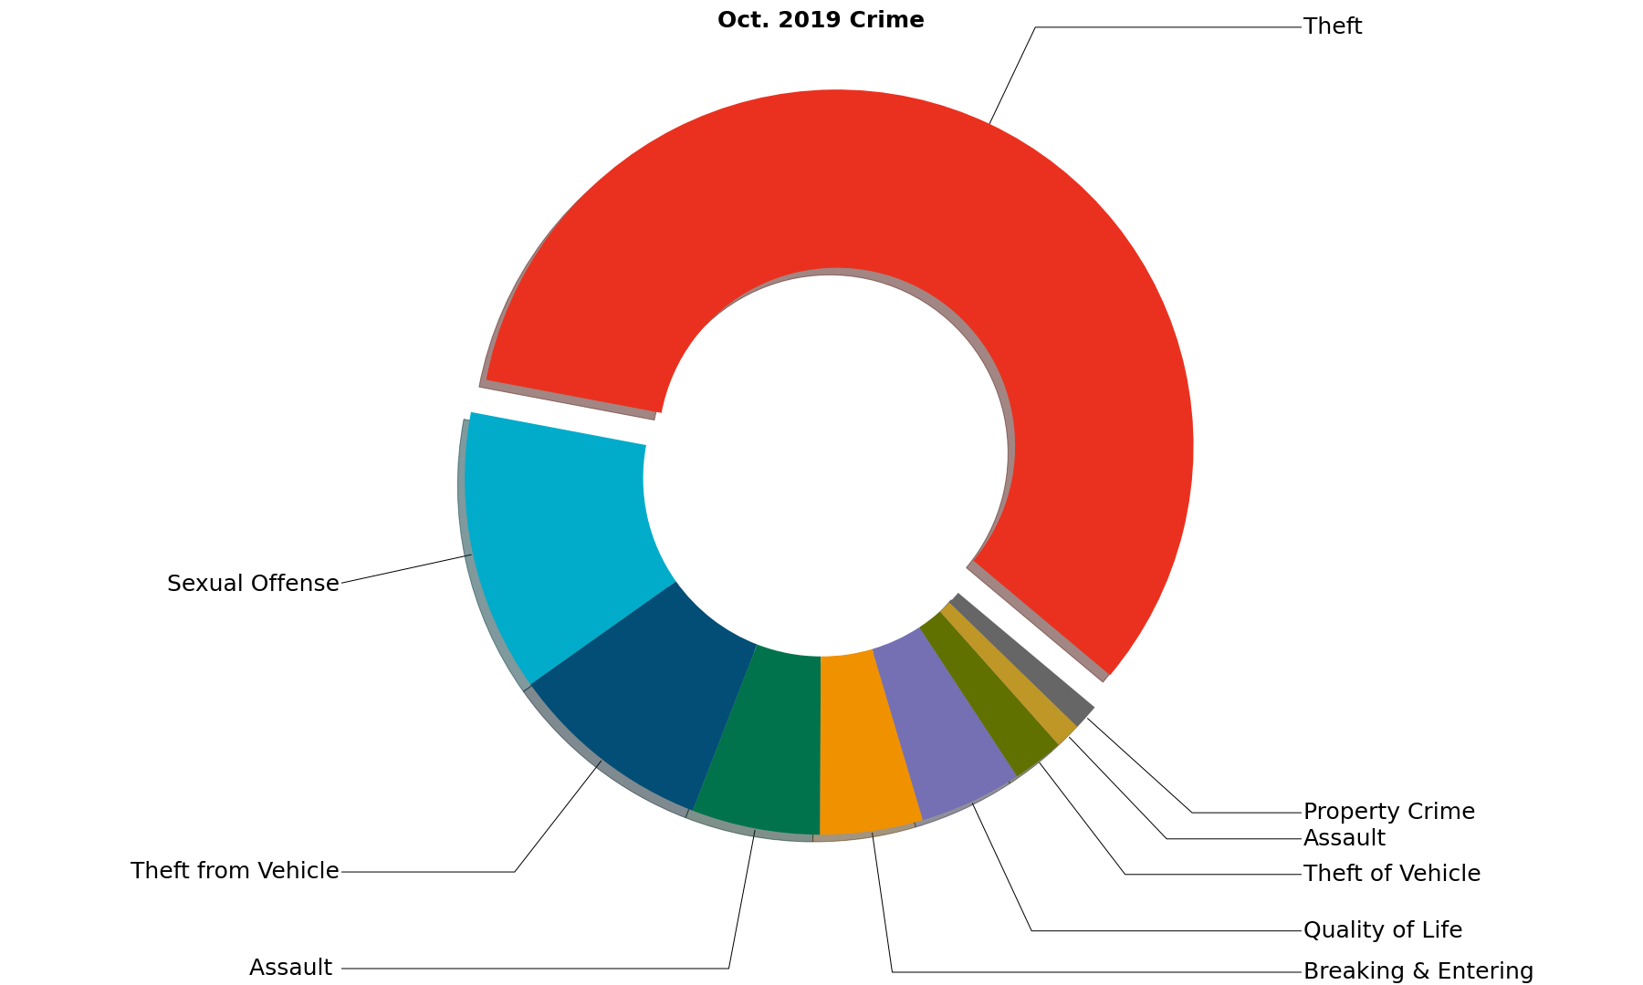
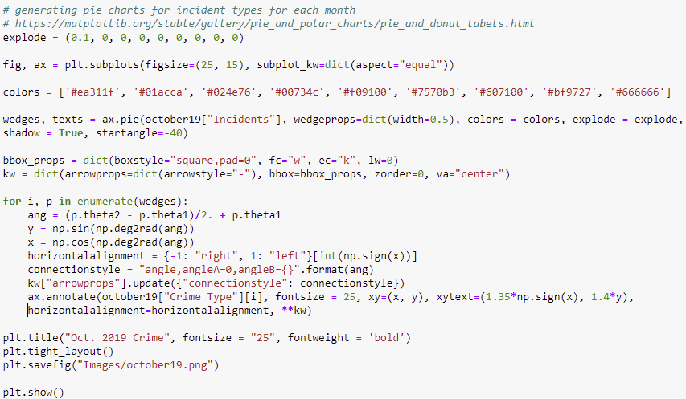
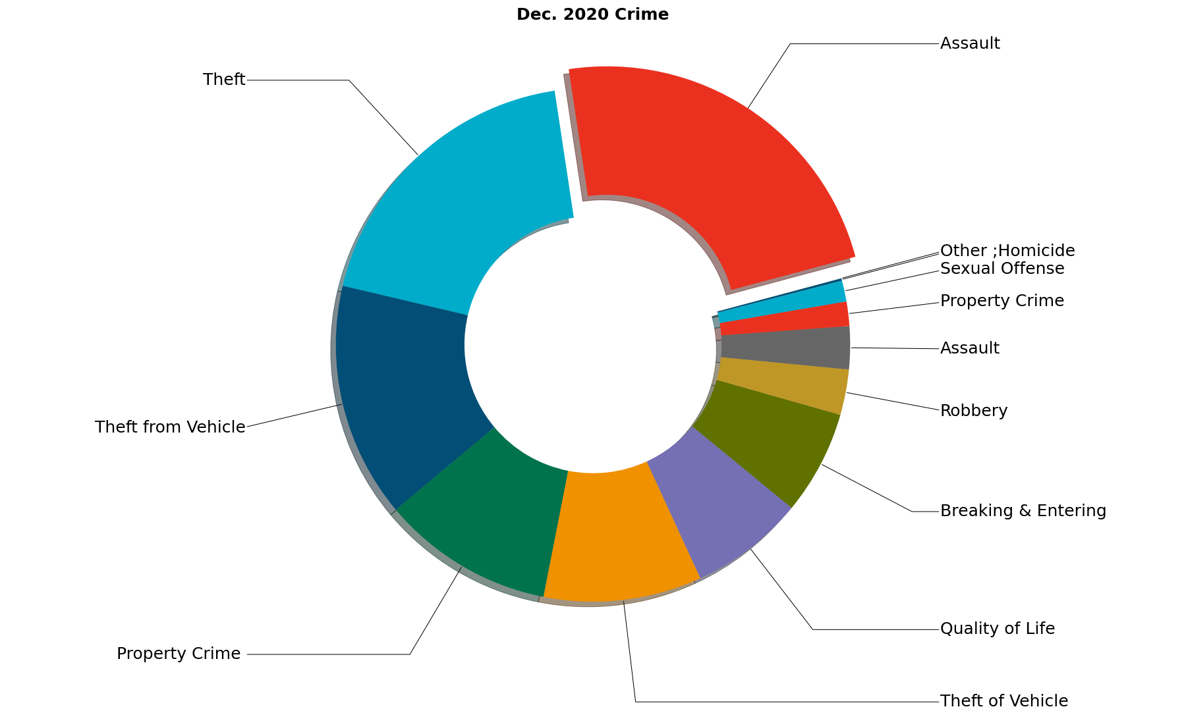
QUESTIONS
DATA ANALYTICS (ONLINE)
DATA SUMMARY
Crime Segments | Assault | Breaking & Entering | Homicide, Other | Property Crime | Quality of Life | Sexual Offense | Robbery, Theft, Theft from and of Vehicle
DATA EXPLORATION
CRIME
ANALYSIS
SUMMARY
IMPLICATIONS
FOR REVIEW
GROUP 4: PROJECT 1

Slide 12
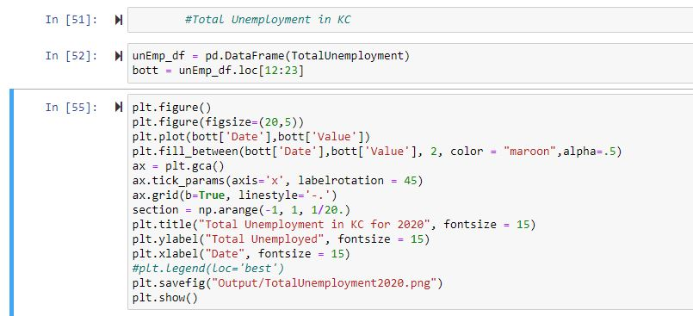
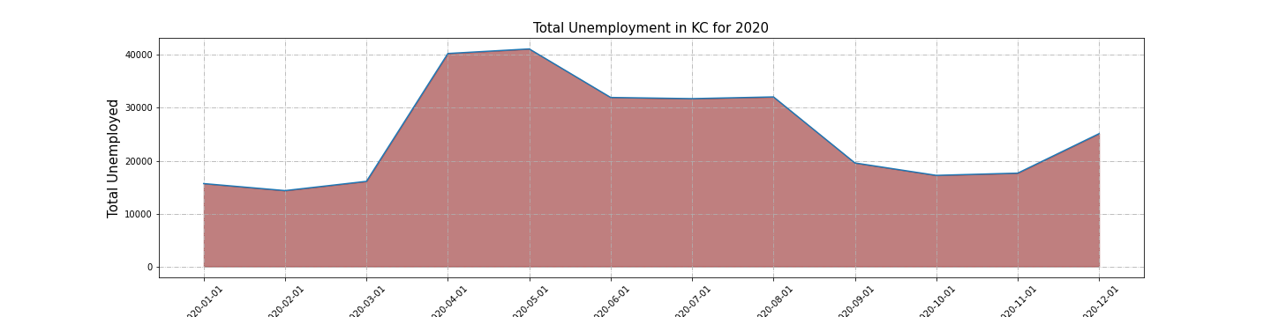
QUESTIONS
DATA ANALYTICS (ONLINE)
DATA SUMMARY
DATA EXPLORATION
UNEMPLOYMENT
ANALYSIS
SUMMARY
IMPLICATIONS
FOR REVIEW
GROUP 4: PROJECT 1

Slide 13
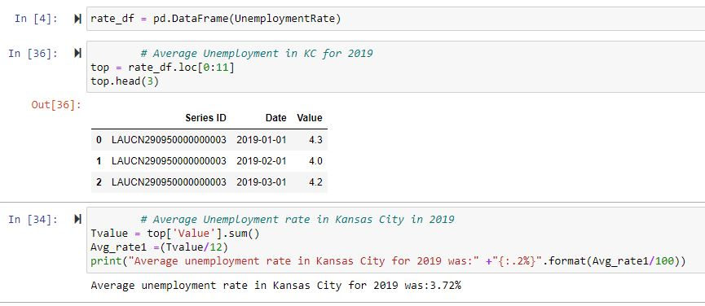
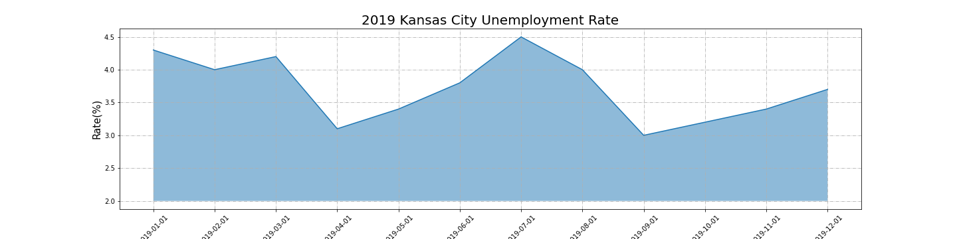
QUESTIONS
DATA ANALYTICS (ONLINE)
DATA SUMMARY
DATA EXPLORATION
UNEMPLOYMENT
ANALYSIS
SUMMARY
IMPLICATIONS
FOR REVIEW
GROUP 4: PROJECT 1

Slide 14
QUESTIONS
DATA ANALYTICS (ONLINE)
DATA SUMMARY
DATA EXPLORATION
ANALYSIS
COVID-19 / CRIME / UNEMPLOYMENT
SUMMARY
IMPLICATIONS
FOR REVIEW
GROUP 4: PROJECT 1

Slide 15
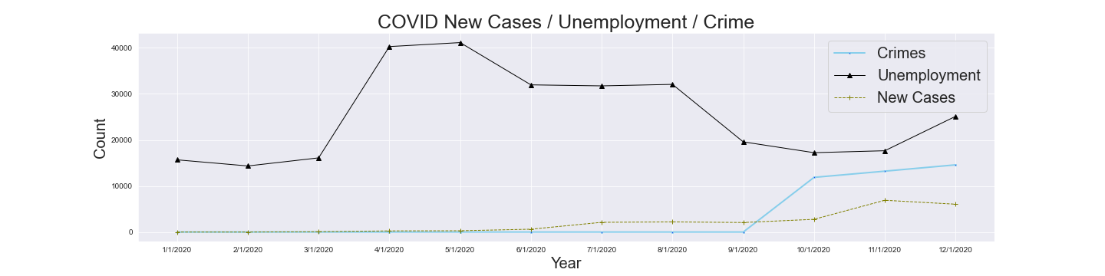
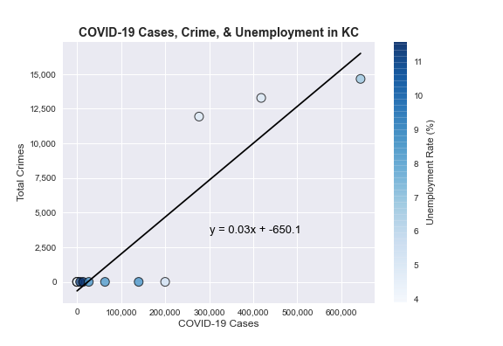
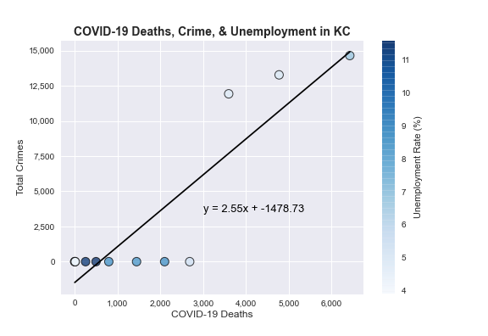
QUESTIONS
DATA ANALYTICS (ONLINE)
DATA SUMMARY
DATA EXPLORATION
ANALYSIS
SUMMARY
IMPLICATIONS
FOR REVIEW
GROUP 4: PROJECT 1

Slide 16
QUESTIONS
DATA ANALYTICS (ONLINE)
DATA SUMMARY
DATA EXPLORATION
ANALYSIS
SUMMARY
IMPLICATIONS
FOR REVIEW
GROUP 4: PROJECT 1

Slide 17
QUESTIONS
DATA ANALYTICS (ONLINE)
DATA SUMMARY
DATA EXPLORATION
ANALYSIS
SUMMARY
IMPLICATIONS
FOR REVIEW
GROUP 4: PROJECT 1

